Slide 1
3. Introduction to physical layer
Sharada Valiveti
Chandan Trivedi
Parita Oza
Umesh Bodkhe

Slide 2
Introduction to physical layer
Move data in the form of electromagnetic signals across a transmission medium
For transmission, data needs to be changed to signals
Objectives:
Study of analog and digital data
Periodic analog signals for data communication and related definitions
Non periodic digital signals for data communication and related definitions
Transmission impairment and related definitions
Data rate limit of channel and related definitions
Performance of data transmission and related definitions
To be transmitted, data must be transformed to electromagnetic signals.

Slide 3
Contents
Data and Signals
Periodic Analog Signals
Digital Signals
Transmission Impairment
Data Rate Limits
Performance

Slide 4
Data and signals
Analog and Digital Data
Analog and Digital Signals
Periodic and Non-periodic

Slide 5
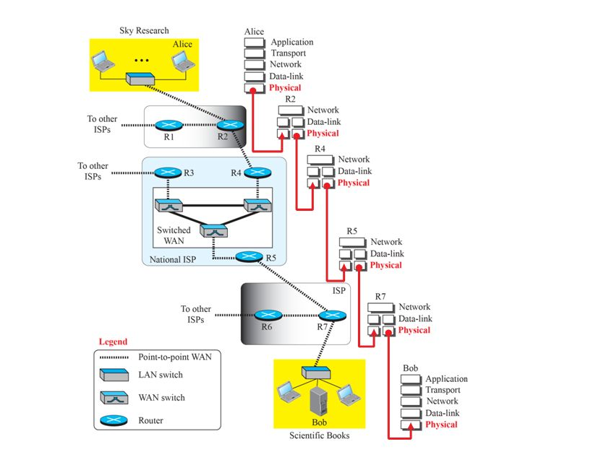
Communication at the Physical Layer

Slide 6
Analog and digital data
Analog data
Information that is continuous
Eg. An analog clock, analog voice create by human beings
Digital data
Information that has discrete states
Eg. A digital clock, data stored in computer memory in form of 1s and 0s

Slide 7
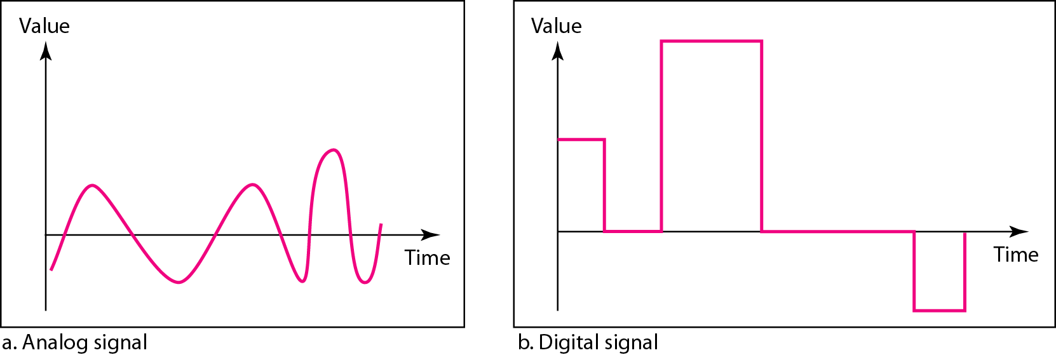
Analog and digital signals
An analog signal has infinitely many levels of intensity over a period of time
A digital signal can have only a limited number of defined values
Comparison of Analog and Digital Signals

Slide 8
Periodic and nonperiodic
A periodic signal completes a pattern within a measurable time frame, called a period
Repeats that pattern over subsequent identical periods
Completion of one full pattern is called a cycle
A nonperiodic signal changes without exhibiting a pattern or cycle that repeats over time
Both analog and digital signals can be periodic or nonperiodic
In data communications, periodic analog signals and nonperiodic digital signals are commonly used

Slide 9
Periodic Analog Signals Simple composite
Sine wave
Phase
Wavelength
Time and Frequency Domains
Composite signals
Bandwidth

Slide 10
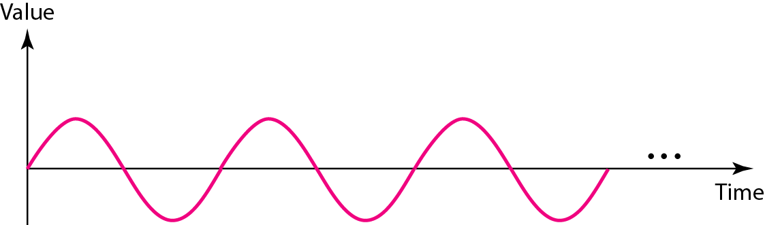
Sine wave
Most fundamental form of a periodic analog signal
Its change over the course of a cycle is smooth and consistent, a continuous, rolling flow
A sine wave

Slide 11
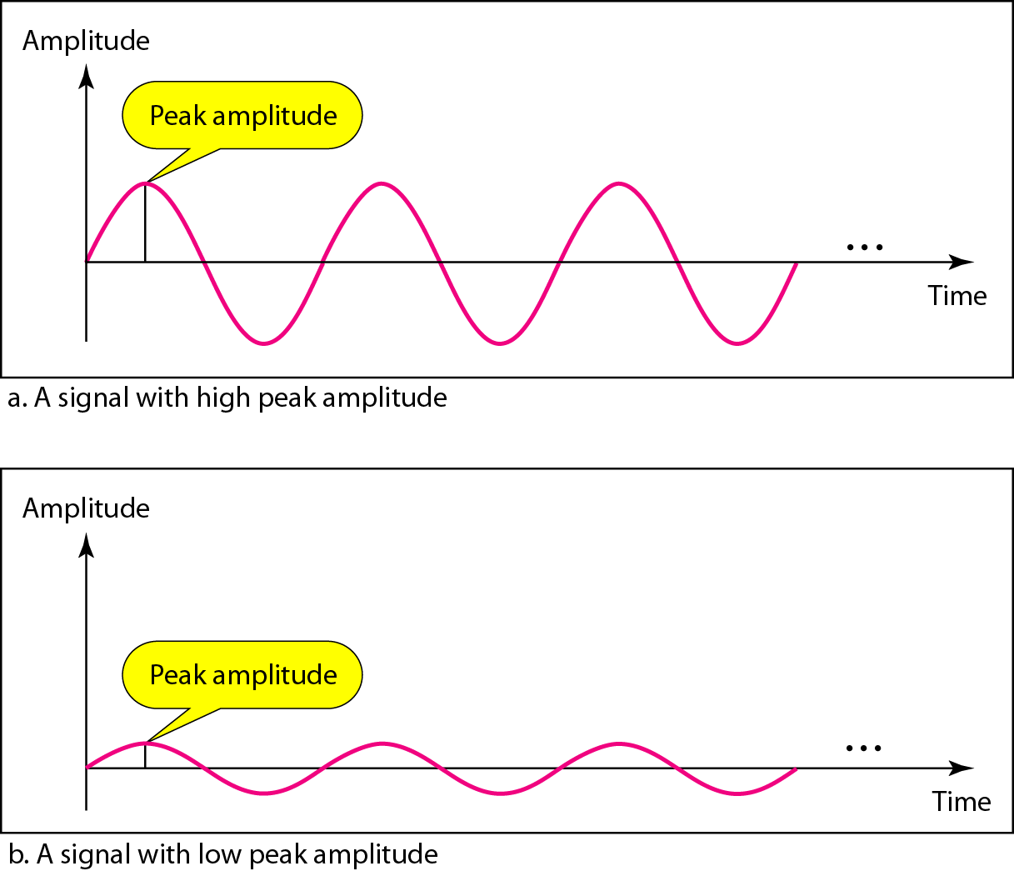
Sine wave
Represented by
The peak amplitude
The frequency and
The phase
Two signals with the same phase and frequency, but different amplitudes

Slide 12
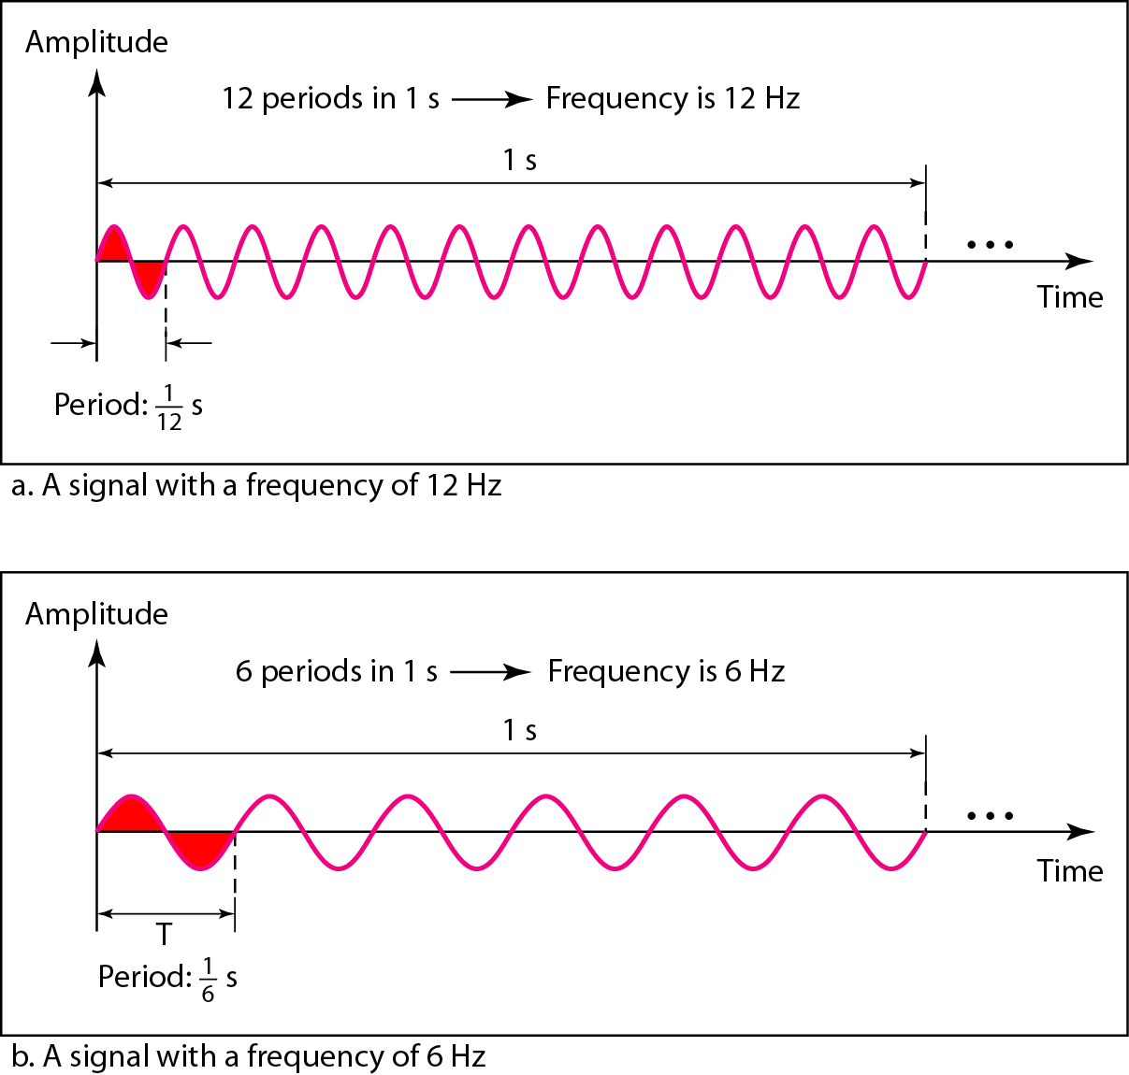
Sine wave
Represented by
The peak amplitude
The frequency and
The phase
Two signals with the same amplitude and phase, but different frequencies

Slide 13

Sine wave
Represented by
The peak amplitude
The frequency and
The phase
Period is amount of time, in seconds, a signal takes to complete one cycle
Frequency refers to number of periods per second
Period is inverse of frequency and vice versa
Frequency and period are inverse of each other

Slide 14
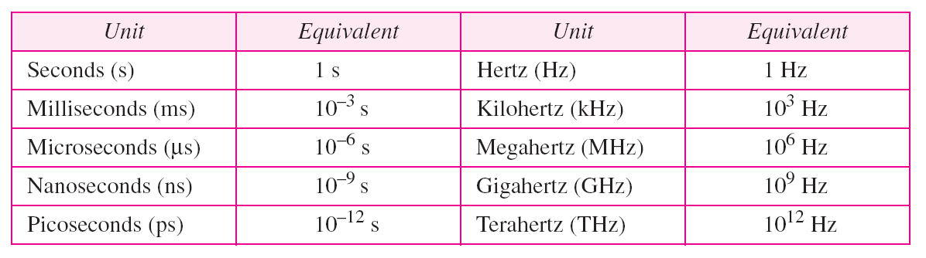
Units of period and frequency

Slide 15
The power we use at home has a frequency of 60 Hz. The period of this sine wave can be determined as follows:

Slide 16
Express a period of 100 ms in microseconds.
100 ms = 100 X 10⁻³ s = 100 X 10⁻³ X 10⁶ μs = 10⁵ μs

Slide 17
The period of a signal is 100 ms. What is its frequency in kilohertz?
Solution
First we change 100 ms to seconds, and then we calculate the frequency from the period (1 Hz = 10⁻³ kHz).

Slide 18
Some extremes of frequency
Relationship of a signal to time and that the frequency of a wave is number of cycles it completes in 1s
Measurement of the rate of change
Electromagnetic signals are the oscillating waveforms
Fluctuate continuously above and below a mean energy level
Change in a short span of time means high frequency
Change over a long span of time means low frequency
If a signal does not change at all, its frequency is zero
If a signal changes continuously, its frequency is infinite

Slide 19
Sine wave
Represented by
The peak amplitude
The frequency and
The phase or phase shift
Phase describes the position of the waveform relative to time 0.
Indicates the status of the first cycle
Phase is measured in degrees or radians (360 or 2Π)

Slide 20
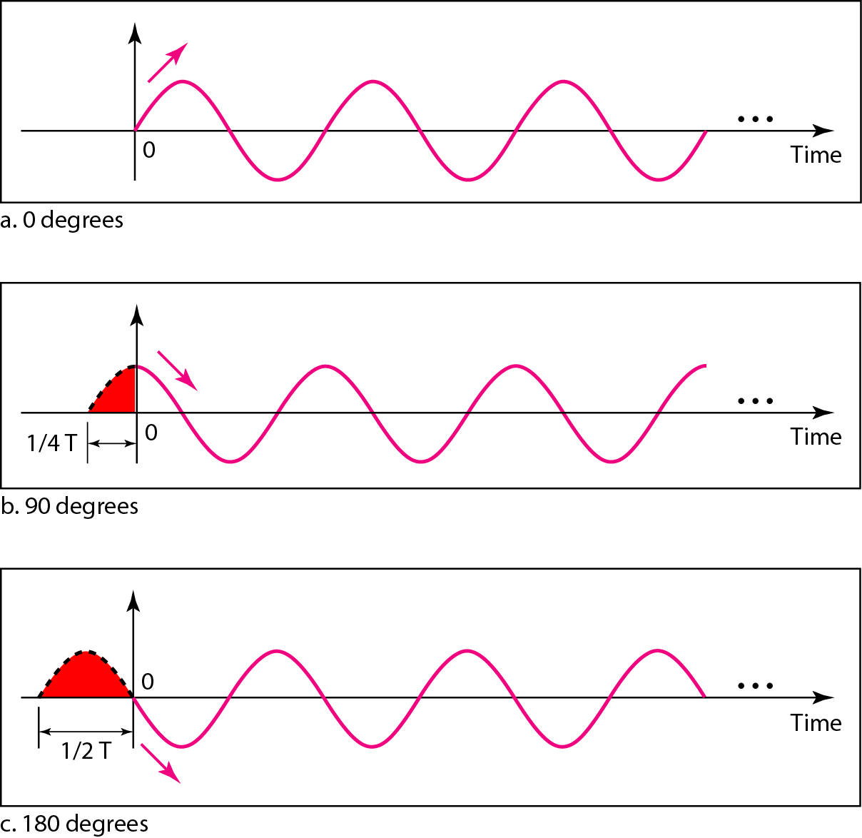
Three signals with the same amplitude and frequency, but different phases

Slide 21
A sine wave is offset 1/6 cycle with respect to time 0. What is its phase in degrees and radians?
Solution
We know that 1 complete cycle is 360°. Therefore, 1/6 cycle is

Slide 22
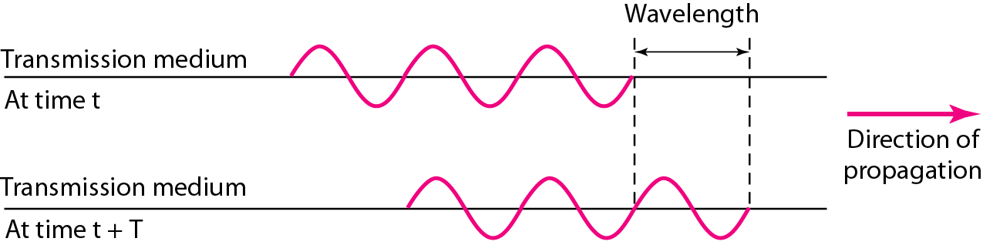
wavelength
Binds period or the frequency of a simple sine wave to the propagation speed of the medium
Wavelength is the distance a simple signal can travel in one period
Wavelength and Period

Slide 23
wavelength
Wavelength (λ) is calculated as
Wavelength = (propagation speed) X period
= (propagation speed)/frequency
λ = c/f
Wavelength is used to describe transmission of light in an optical fiber.

Slide 24
Time and frequency domains
Time domain plot shows changes in signal amplitude with respect to time
A frequency domain plot is concerned with the peak value and the frequency; changes in amplitude during one period are not shown
Frequency domain is more compact and useful when dealing with more than one sine wave
A complete sine wave in the time domain can be represented by one single spike in the frequency domain.

Slide 25
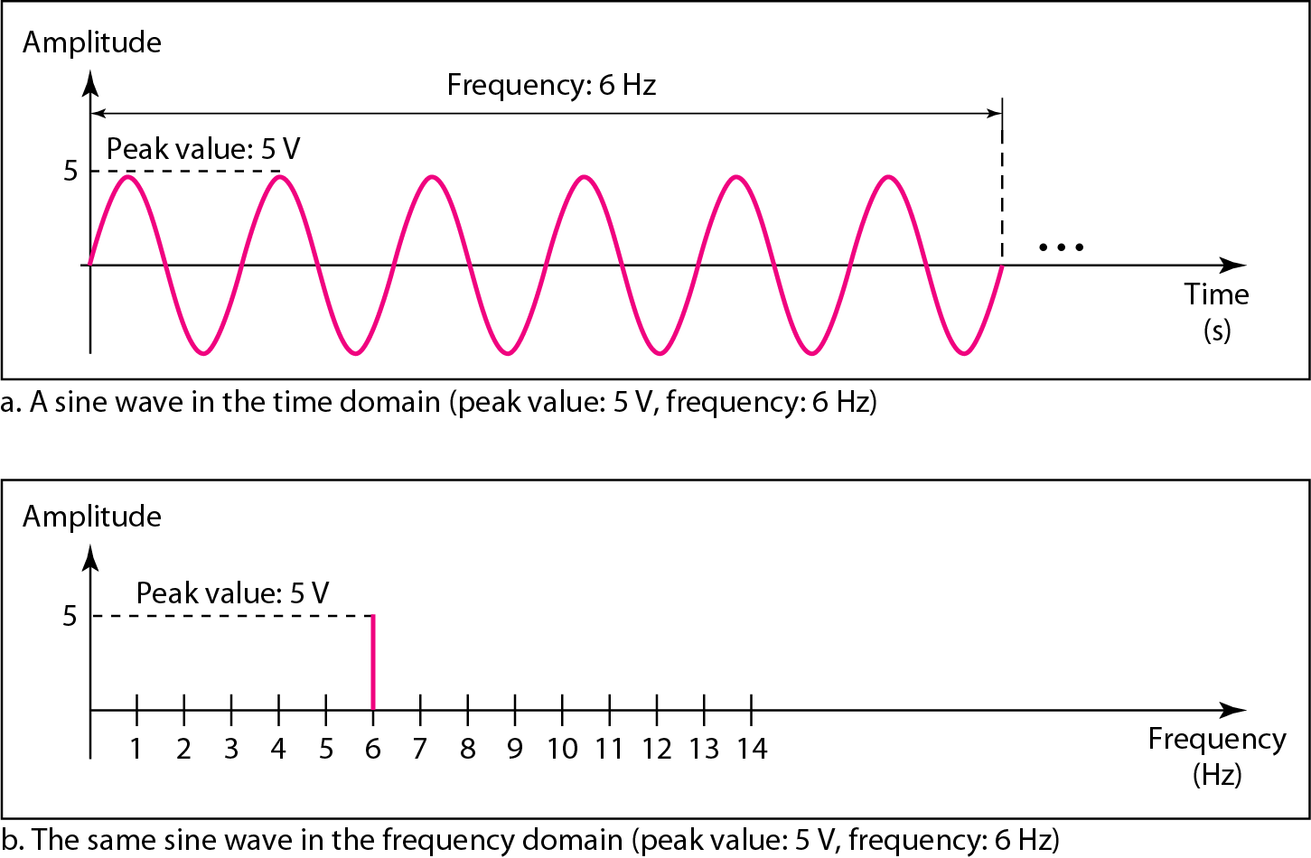
Time and frequency domain of a sine wave
A complete sine wave in the time domain can be represented by one single spike in the frequency domain

Slide 26
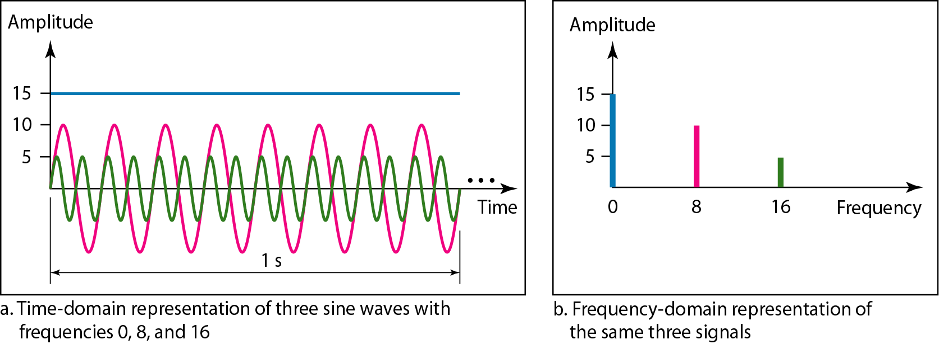
The time domain and frequency domain of three sine waves

Slide 27
Composite signals
A single-frequency sine wave is not useful in data communications
Composite signals are a combination of simple sine waves with different frequencies, amplitudes, and phases (According to Jean-Bapstite Fourier)
Composite signal can be periodic or nonperiodic
Periodic composite signal can be decomposed into a series of simple sine waves with discrete frequencies
Nonperiodic composite signals can be decomposed into a combination of an infinite number of simple sine waves with continuous frequencies

Slide 28
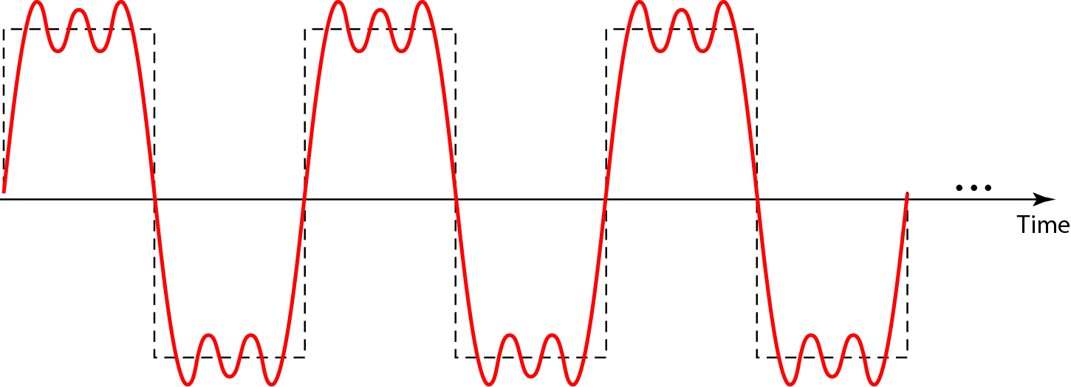
A composite periodic signal

Slide 29
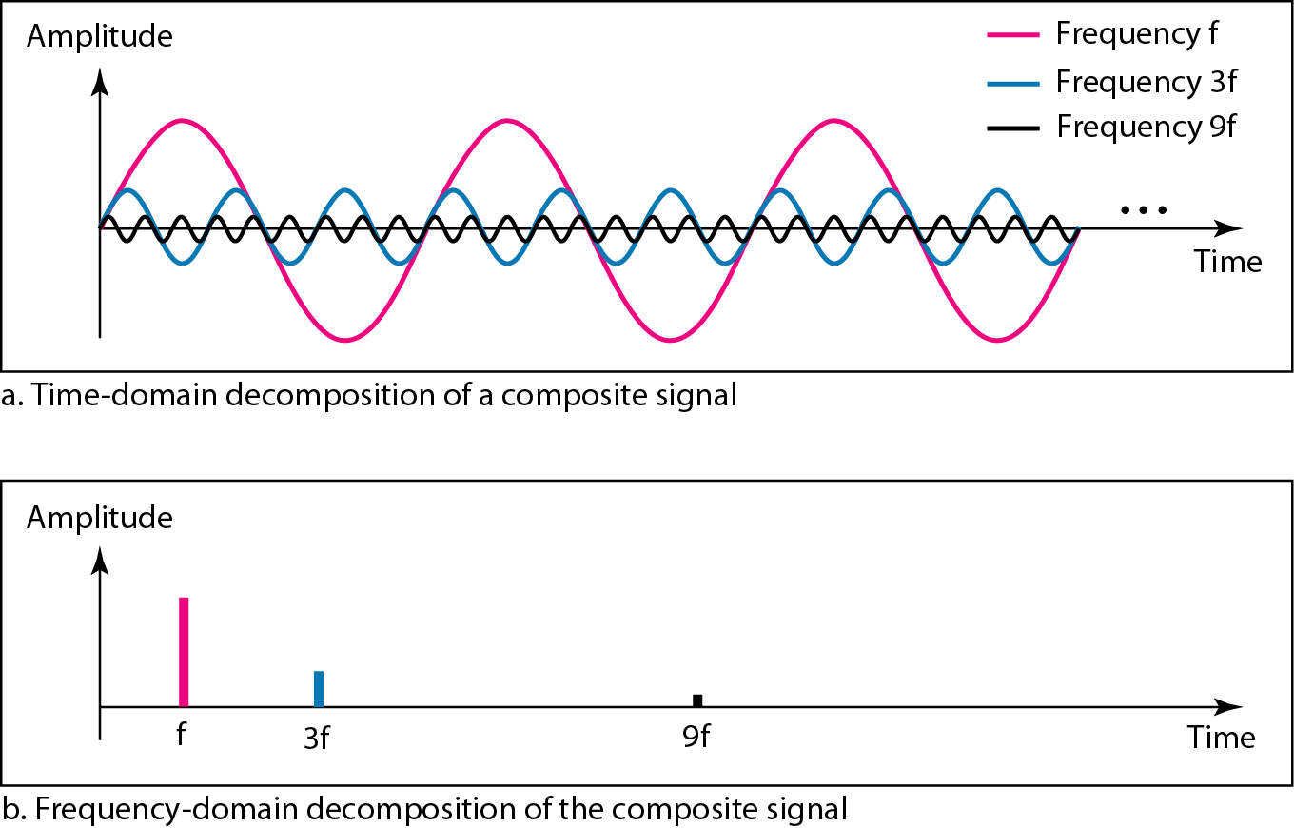
Decomposition of a composite periodic signal in the time and frequency domain

Slide 30
Composite signals
First harmonic or fundamental frequency
If decomposed signal has the same frequency as that of composite periodic signal, it is called first harmonic or fundamental frequency
If the decomposed signal has twice the frequency of composite periodic signal, it is called second harmonic
Third harmonic
And so on
Here, first harmonic, third harmonic and ninth harmonic are shown
Frequency decomposition of a signal is discrete
Since f is integral, 3f and 9f are also integral
No frequencies exist like 1.2f or 2.6 f

Slide 31
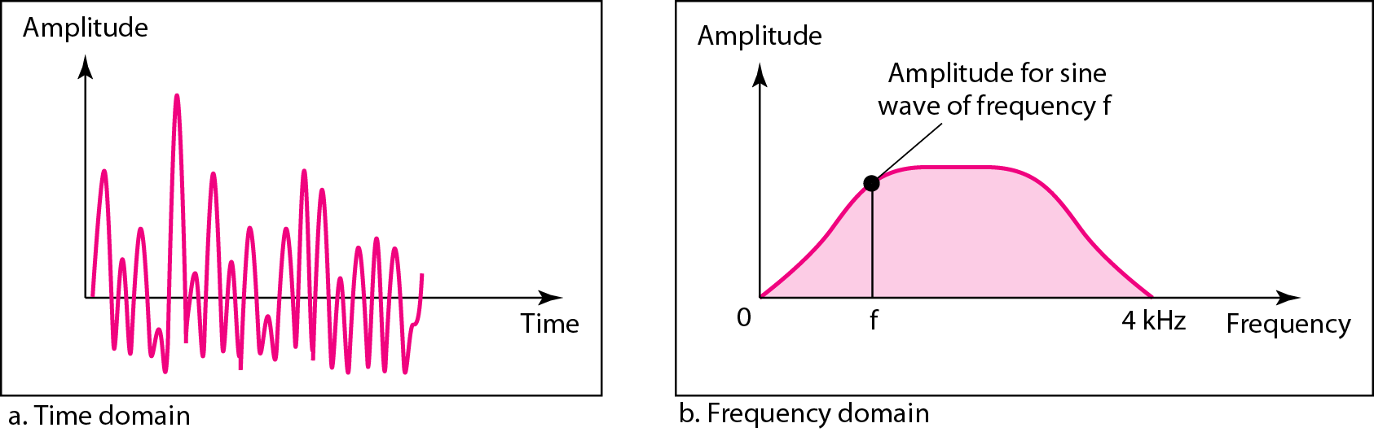
Time and Frequency domains of a nonperiodic signal

Slide 32
bandwidth
Range of frequencies contained in a composite signal is its bandwidth
Difference between the highest and the lowest frequencies contained in that signal

Slide 33
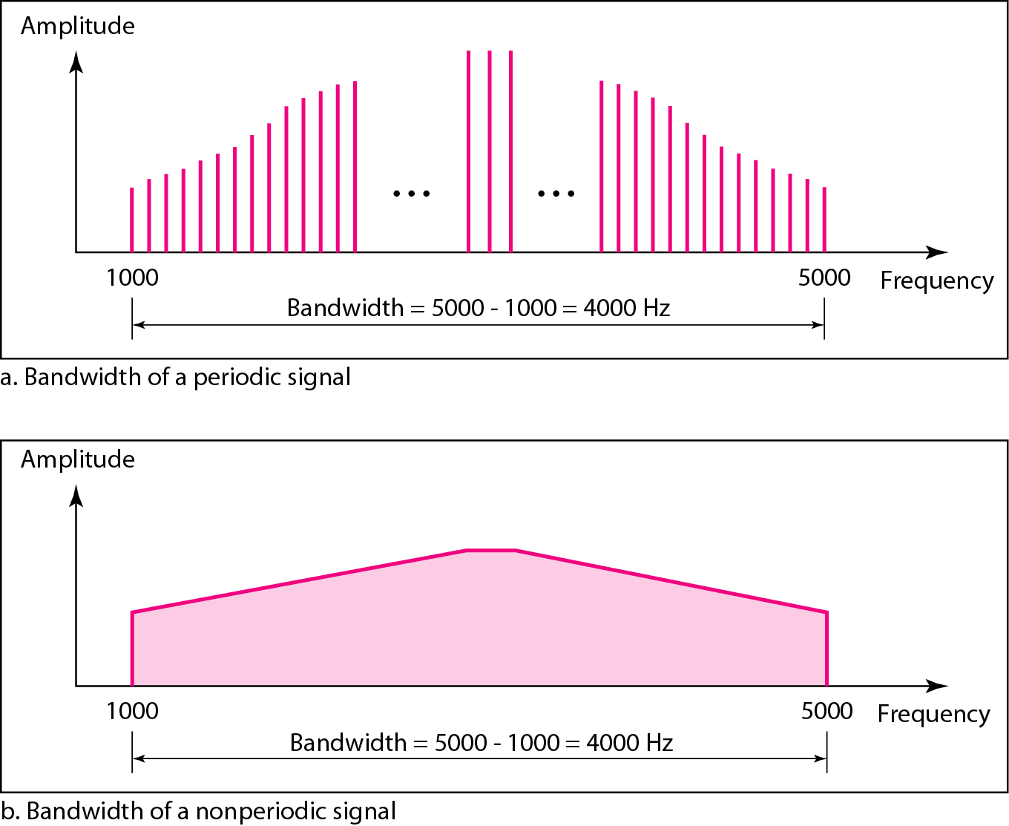
Bandwidth of a nonperiodic signal

Slide 34
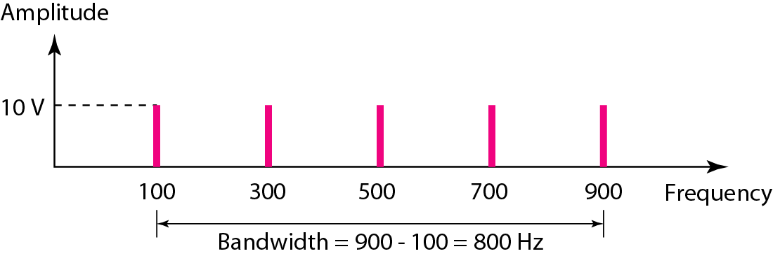
If a periodic signal is decomposed into five sine waves with frequencies of 100, 300, 500, 700, and 900 Hz, what is its bandwidth? Draw the spectrum, assuming all components have a maximum amplitude of 10 V.
Let f_{h} be the highest frequency, f_{l} the lowest frequency, and B the bandwidth. Then
The spectrum has only five spikes, at 100, 300, 500, 700, and 900 Hz

Slide 35
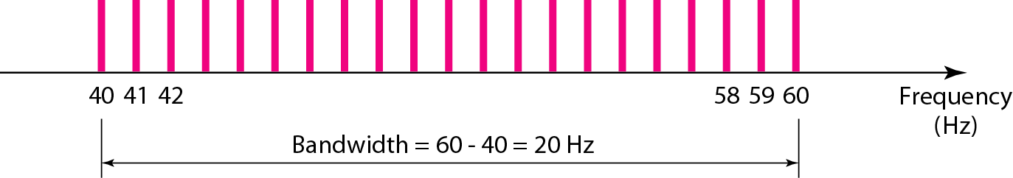
A periodic signal has a bandwidth of 20 Hz. The highest frequency is 60 Hz. What is the lowest frequency? Draw the spectrum if the signal contains all frequencies of the same amplitude.
Let f_{h} be the highest frequency, f_{l} the lowest frequency, and B the bandwidth. Then
The spectrum contains all integer frequencies. We show this by a series of spikes

Slide 36
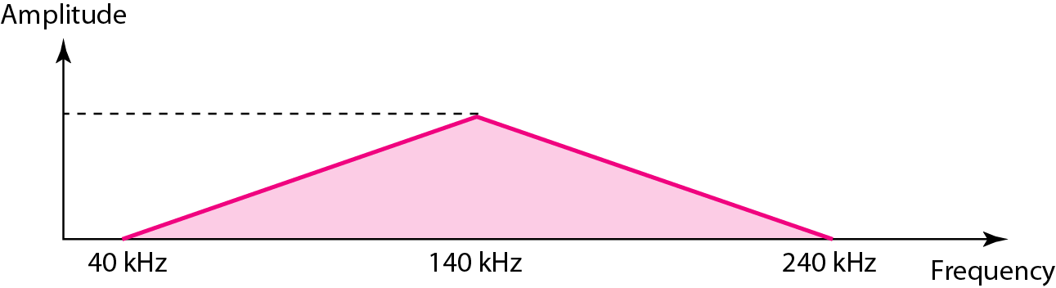
A nonperiodic composite signal has a bandwidth of 200 kHz, with a middle frequency of 140 kHz and peak amplitude of 20 V. The two extreme frequencies have an amplitude of 0. Draw the frequency domain of the signal.
The lowest frequency must be at 40 kHz and the highest at 240 kHz

Slide 37
An example of a nonperiodic composite signal is the signal propagated by an AM radio station. In the United States, each AM radio station is assigned a 10-kHz bandwidth. The total bandwidth dedicated to AM radio ranges from 530 to 1700 kHz.
Another example of a nonperiodic composite signal is the signal propagated by an FM radio station. In the United States, each FM radio station is assigned a 200-kHz bandwidth. The total bandwidth dedicated to FM radio ranges from 88 to 108 MHz.
Another example of a nonperiodic composite signal is the signal received by an old-fashioned analog black-and-white TV. A TV screen is made up of pixels. If we assume a resolution of 525 × 700, we have 367,500 pixels per screen. If we scan the screen 30 times per second, this is 367,500 × 30 = 11,025,000 pixels per second. The worst-case scenario is alternating black and white pixels. We can send 2 pixels per cycle. Therefore, we need 11,025,000 / 2 = 5,512,500 cycles per second, or Hz. The bandwidth needed is 5.5125 MHz.

Slide 38
Digital signals
Bit Rate
Bit Length
Digital Signal as a Composite Analog Signal
Transmission of Digital Signals

Slide 39
Digital signal
Information can be represented by a digital signal
If a signal has L levels, each level needs log₂L bits
Example:
A digital signal has eight levels. How many bits are needed per level? We calculate the number of bits from the formula
Each signal level is represented by 3 bits

Slide 40
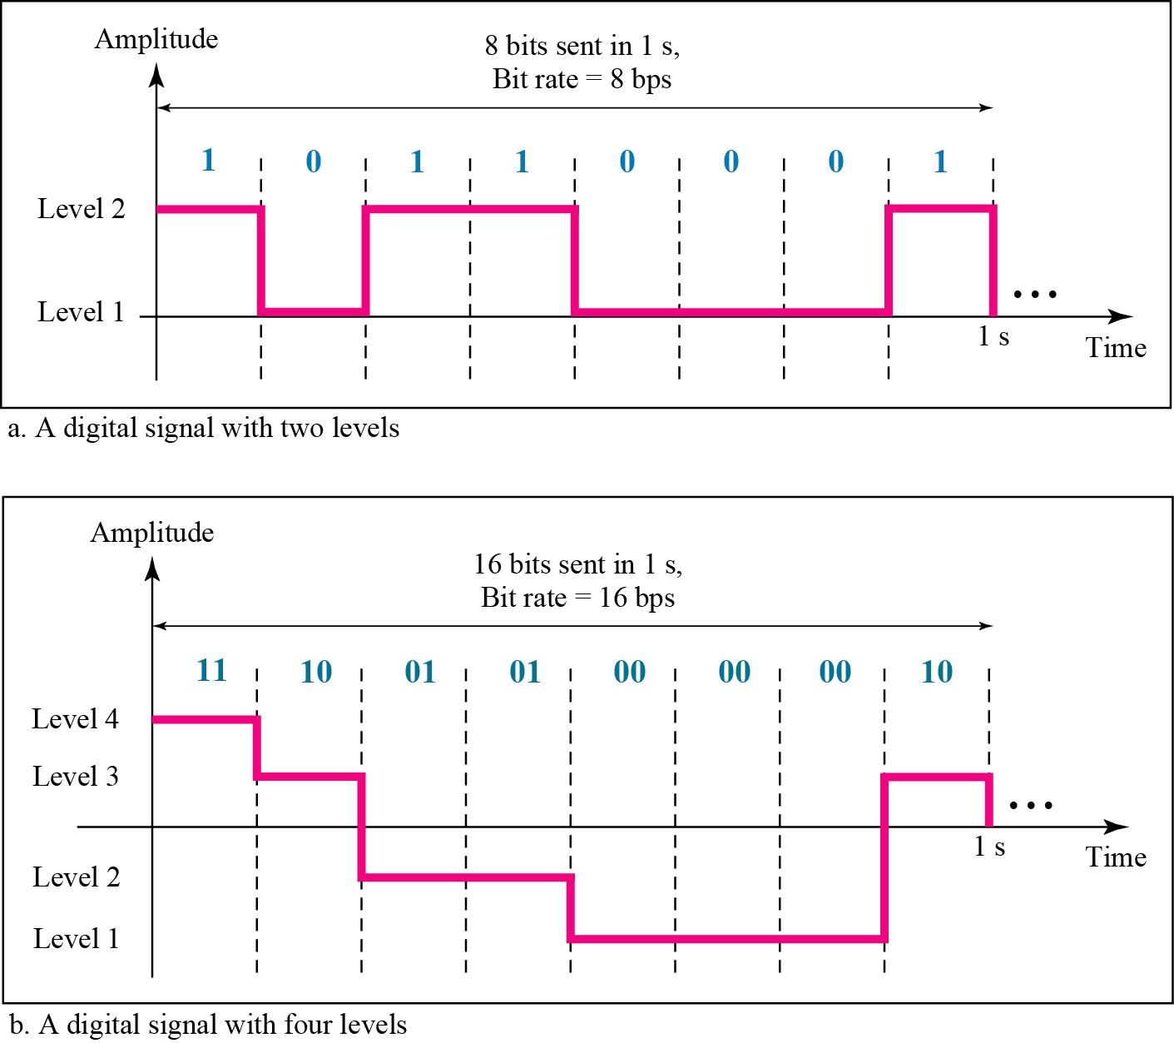
Two digital signals: one with two signal levels and other with four signal levels

Slide 41
A digital signal has nine levels. How many bits are needed per level?
Each signal level is represented by 3.17 bits
However, this answer is not realistic.
The number of bits sent per level needs to be an integer as well as a power of 2.
For this example, 4 bits can represent one level.

Slide 42
Bit rate
Bit rate is the number of bits sent in 1s, expressed in bits per second (bps)
Example:
Assume we need to download text documents at the rate of 100 pages per sec. What is the required bit rate of the channel?
Solution
A page is an average of 24 lines with 80 characters in each line. If we assume that one character requires 8 bits (ASCII), the bit rate is 100 X 24 X 80 X 8 = 1.536 Mbps

Slide 43
A digitized voice channel, is made by digitizing a 4-kHz bandwidth analog voice signal. We need to sample the signal at twice the highest frequency (two samples per hertz). We assume that each sample requires 8 bits. What is the required bit rate?
The bit rate can be calculated as
What is the bit rate for high-definition TV (HDTV)?
HDTV uses digital signals to broadcast high quality video signals. The HDTV screen is normally a ratio of 16 : 9. There are 1920 by 1080 pixels per screen, and the screen is renewed 30 times per second. Twenty-four bits represents one color pixel
The TV stations reduce this rate to 20 to 40 Mbps through compression

Slide 44
Bit length
Similar to wavelength for analog signals
The bit length is the distance one bit occupies on the transmission medium
Bit length = propagation speed X bit duration

Slide 45
Digital signal as a composite analog signal
A digital signal is a composite analog signal
Infinite bandwidth
Periodic digital signal
Rare in data communication
Frequency domain representation has infinite bandwidth and discrete frequencies
Nonperiodic digital signal
Decomposed signal still has an infinite bandwidth
Frequencies are continuous

Slide 46
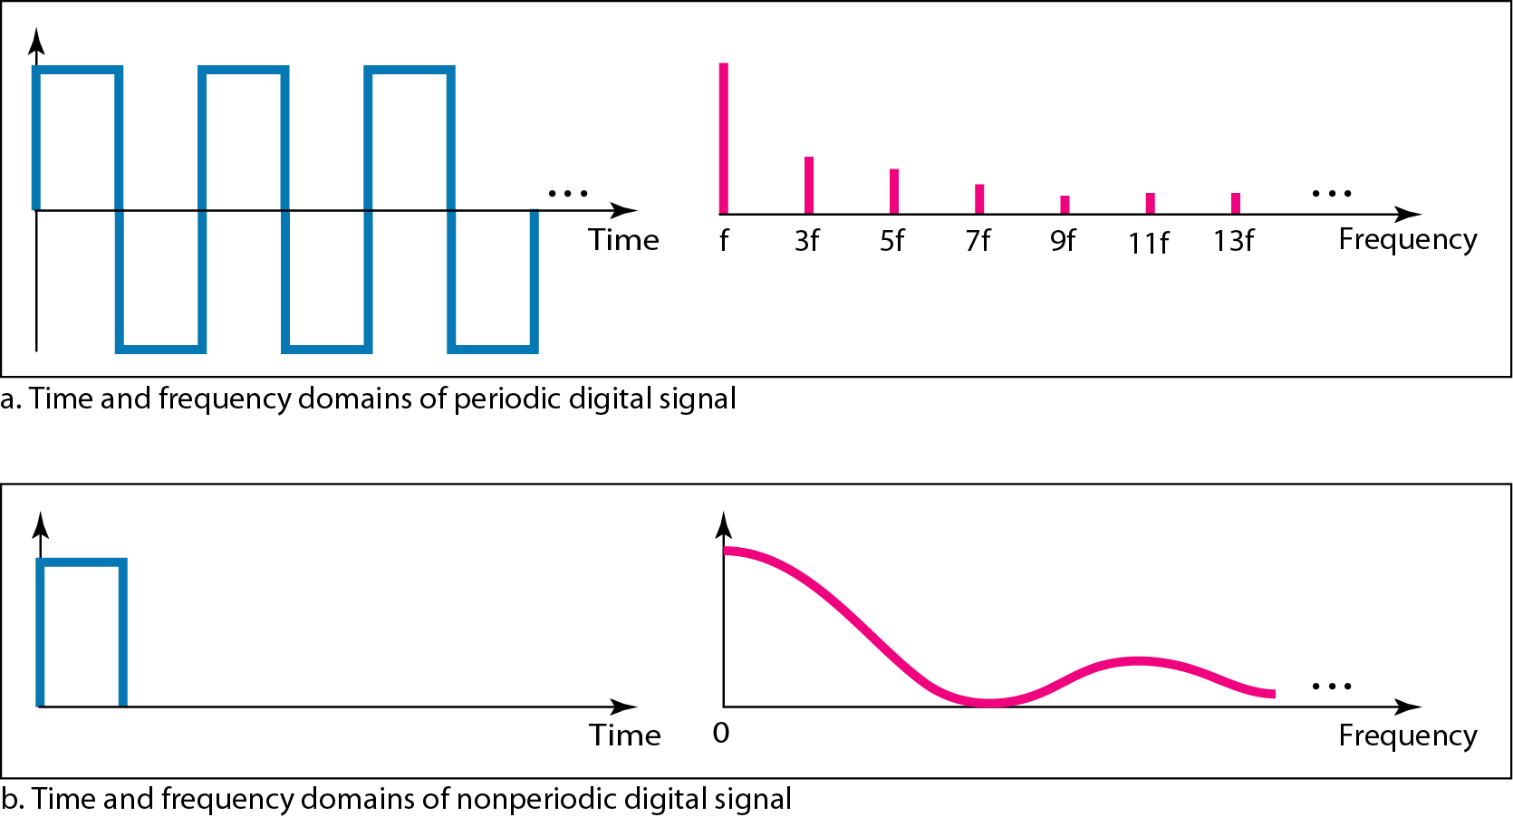
The time and frequency domains of periodic and nonperiodic digital signals

Slide 47
Transmission of digital signals
Digital signal is a composite analog signal with frequencies between zero and infinity
Transmission of digital signal is possible by 2 approaches
Baseband transmission
Broadband transmission (using modulation)

Slide 48
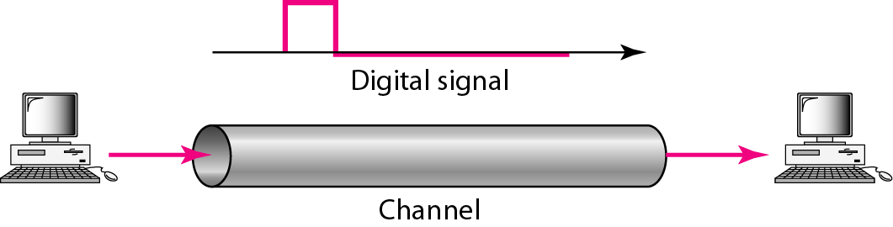
Transmission of digital signals: baseband transmission
Baseband Transmission
Sending a digital signal over a channel without changing the digital signal to an analog signal
Requires a low-pass channel with a bandwidth that starts from zero
Means a dedicated medium with a bandwidth constituting only one channel

Slide 49
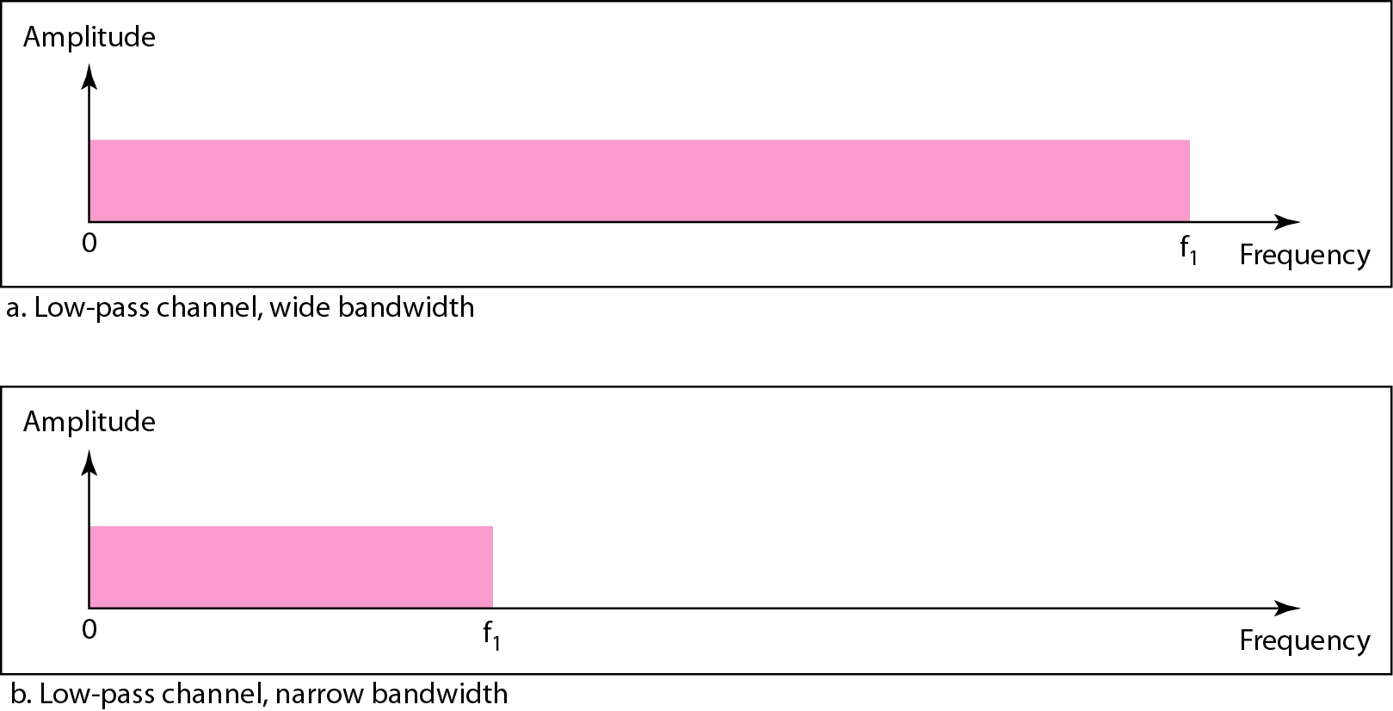
Bandwidths of Low pass channels

Slide 50
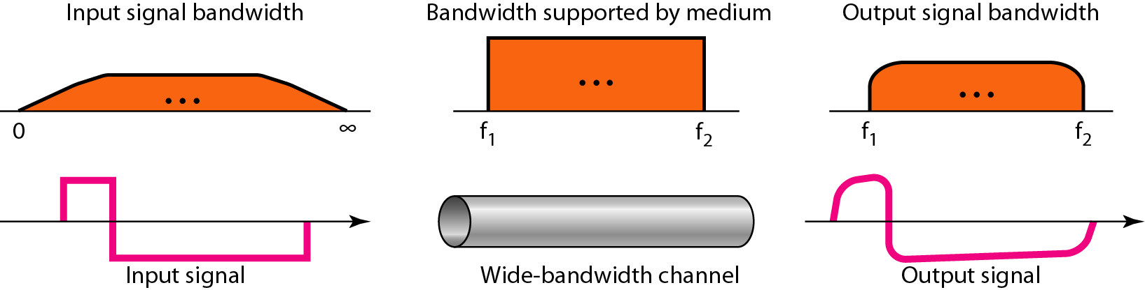
Baseband transmission using a dedicated medium
An example of a dedicated channel where the entire bandwidth of the medium is used as one single channel is a LAN. Almost every wired LAN today uses a dedicated channel for two stations communicating with each other. In a bus topology LAN with multipoint connections, only two stations can communicate with each other at each moment in time (timesharing); the other stations need to refrain from sending data. In a star topology LAN, the entire channel between each station and the hub is used for communication between these two entities.
Baseband transmission of a digital signal that preserves the shape of the digital signal is possible only if we have a low-pass channel with an infinite or very wide bandwidth

Slide 51
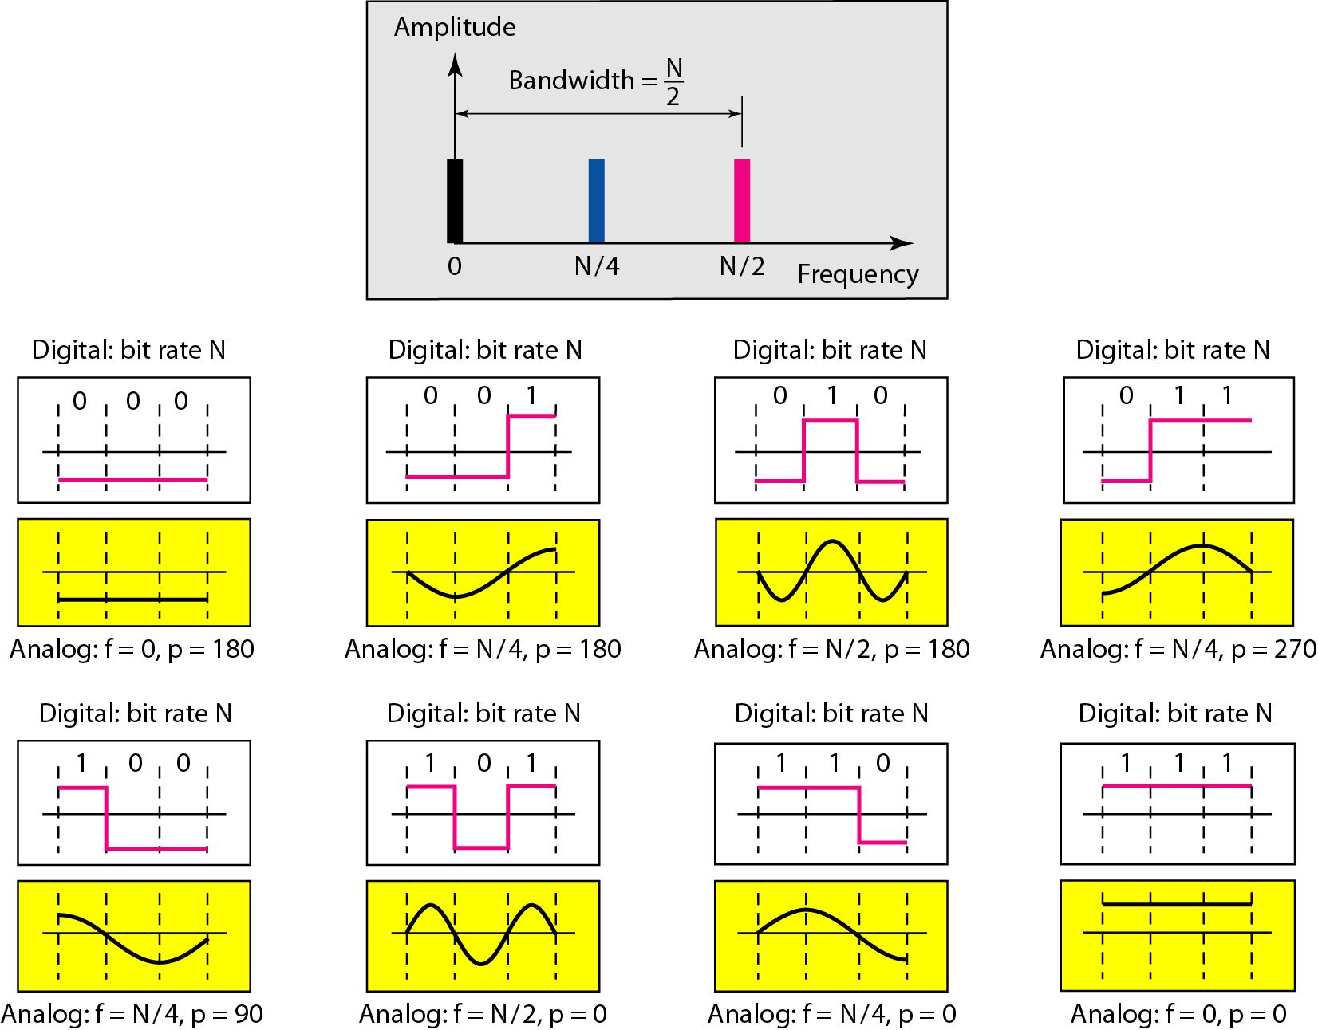
Rough approximation of a digital signal using first harmonic for worst case
Assumption: We have a digital signal of bit rate N
Conclusions:
Analog representation for the 3-bit pattern is shown
Phases involved are 90, 180, 270, 0
Highest frequency is N/2 and lowest frequency is 0
Bandwidth = N/2 (First harmonic)

Slide 52
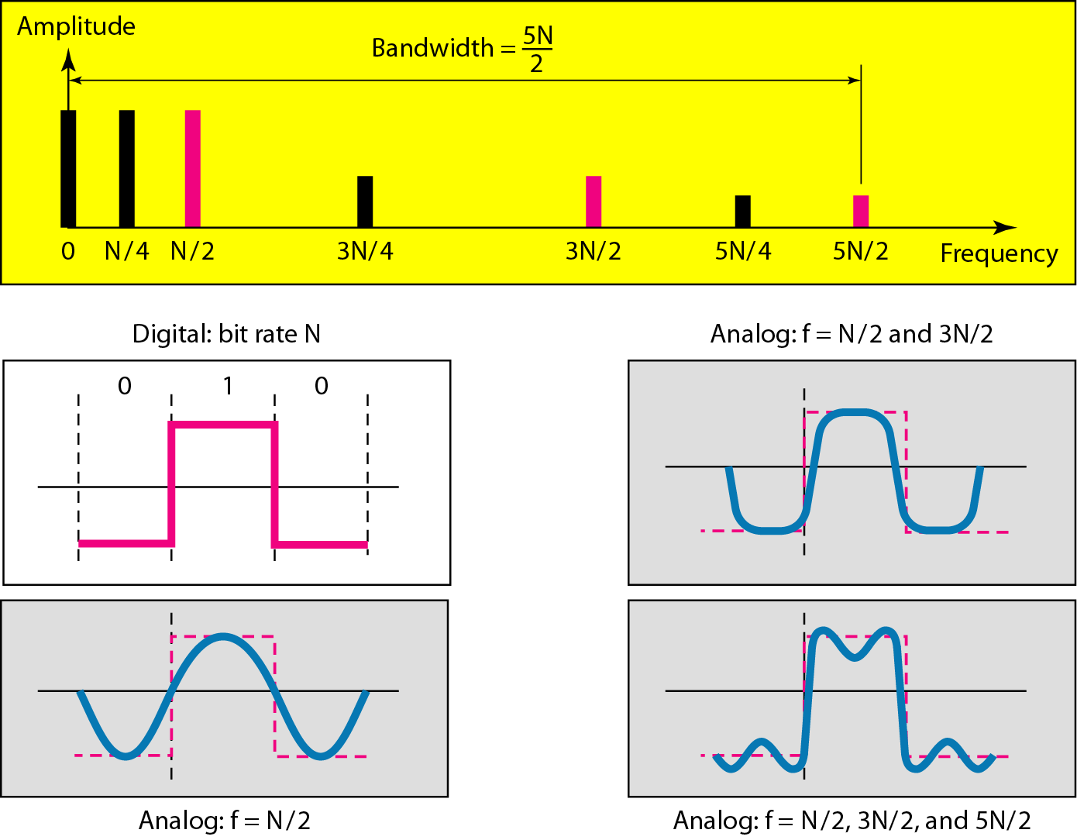
Simulating the digital signal with first three harmonics
Better approximation:
Add more harmonics and increase bandwidth to 3N/2, 5N/2, 7N/2 and so on
Required bandwidth is proportional to bit rate
Want to send bits faster, need more bandwidth

Slide 53
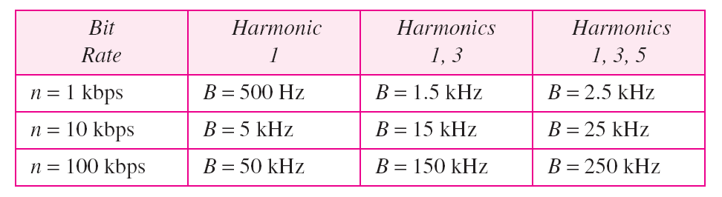
Bandwidth requirements

Slide 54
What is the required bandwidth of a low-pass channel if we need to send 1 Mbps by using baseband transmission?
The answer depends on the accuracy desired.
a. The minimum bandwidth, is B = bit rate /2, or 500 kHz.
b. A better solution is to use the first and the third harmonics with B = 3 × 500 kHz = 1.5 MHz.
c. Still a better solution is to use the first, third, and fifth harmonics with B = 5 × 500 kHz = 2.5 MHz.

Slide 55
We have a low-pass channel with bandwidth 100 kHz. What is the maximum bit rate of this channel?
The maximum bit rate can be achieved if we use the first harmonic. The bit rate is 2 times the available bandwidth, or 200 kbps

Slide 56
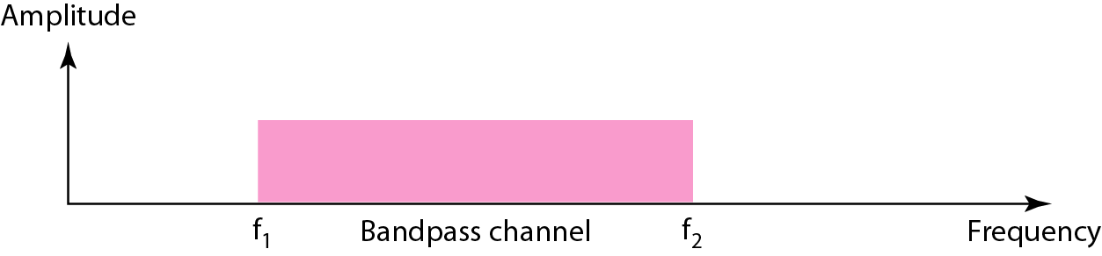
Broadband transmission (Using modulation)
Changing a digital signal into analog signal for transmission
Modulation allows us to use a bandpass channel
A channel with bandwidth that does not start from 0
More available than a low-pass channel
Bandwidth of a Bandpass channel

Slide 57
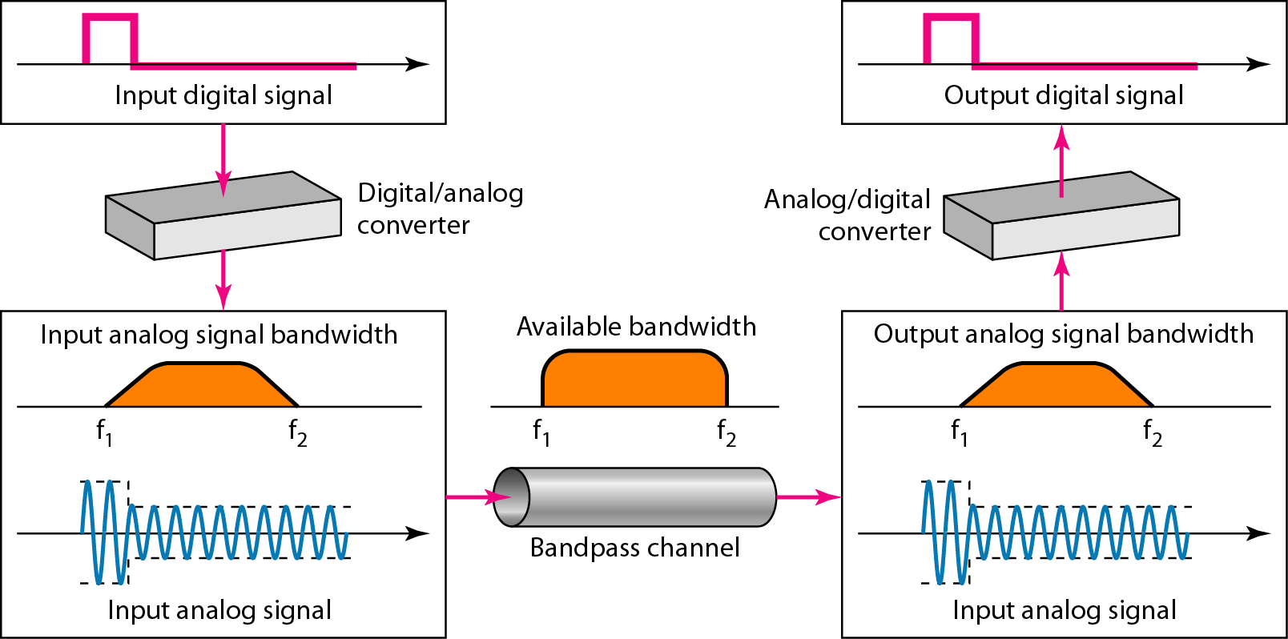
Modulation of a digital signal for transmission on a bandpass channel
If the available channel is a bandpass channel, we cannot send the digital signal directly to the channel; we need to convert the digital signal to an analog signal before transmission.

Slide 58
An example of broadband transmission using modulation is the sending of computer data through a telephone subscriber line, the line connecting a resident to the central telephone office. These lines are designed to carry voice with a limited bandwidth. The channel is considered a bandpass channel. We convert the digital signal from the computer to an analog signal, and send the analog signal. We can install two converters to change the digital signal to analog and vice versa at the receiving end. The converter, in this case, is called a modem
A second example is the digital cellular telephone. For better reception, digital cellular phones convert the analog voice signal to a digital signal. Although the bandwidth allocated to a company providing digital cellular phone service is very wide, we still cannot send the digital signal without conversion. The reason is that we only have a bandpass channel available between caller and callee. We need to convert the digitized voice to a composite analog signal before sending.

Slide 59
Transmission impairment
Attenuation
Distortion
Noise

Slide 60
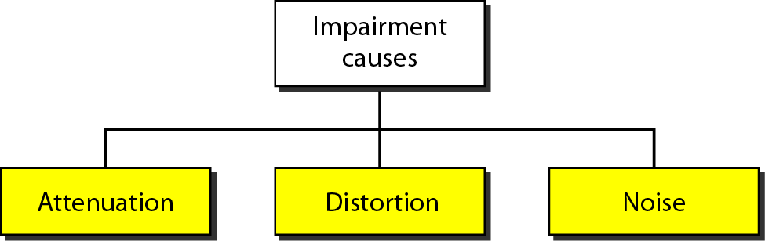
Causes of Impairment
Signals travel through transmission media, which are not perfect
Imperfection causes signal impairment
Signal at the beginning of the medium is not the same as the signal at the ned of medium

Slide 61
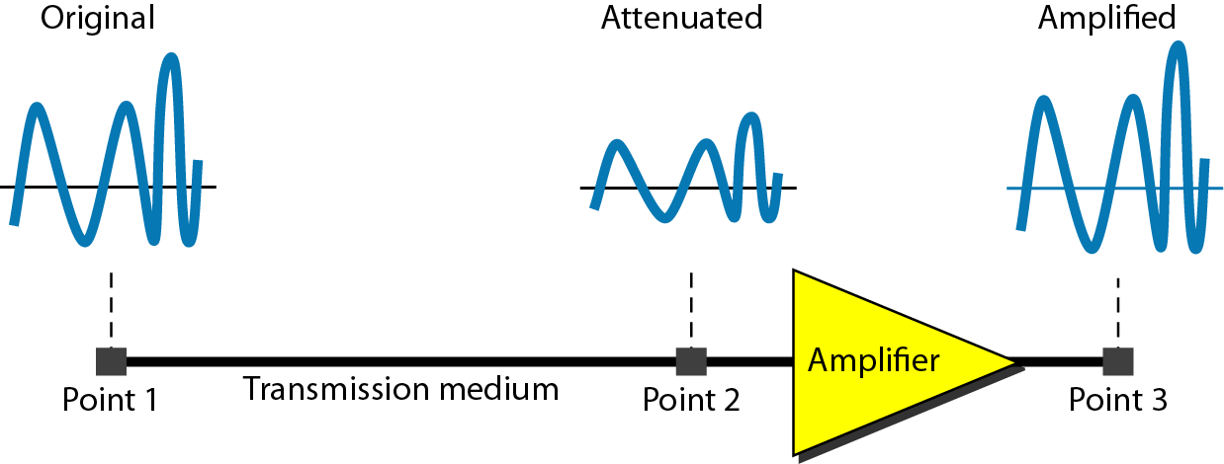
Attenuation
Loss of energy
Signal loses some energy in overcoming the resistance of medium
Hence, amplifiers are used to amplify the signal
Attenuation

Slide 62

Measurement of Attenuation
Measured in decibels
dB = 10log₁₀(P₂/P₁)
P₁ - input signal
P₂ - output signal
Some books define decibels in terms of voltage instead of power. In such a case,
dB = 20log₁₀(V₂/V₁)
V₁ - input voltage
V₂ - output voltage
Suppose a signal travels through a transmission medium and its power is reduced to one-half. This means that P2 is (1/2)P1. In this case, the attenuation (loss of power) can be calculated as
A loss of 3 dB (–3 dB) is equivalent to losing one-half the power

Slide 63

A signal travels through an amplifier, and its power is increased 10 times. This means that P₂ = 10P₁ . In this case, the amplification (gain of power) can be calculated as

Slide 64
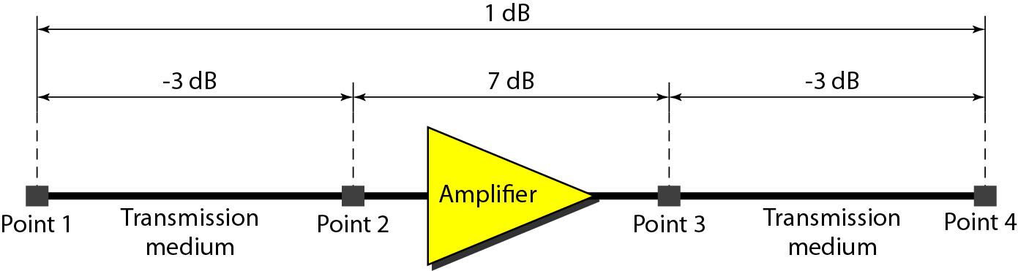

One reason that engineers use the decibel to measure the changes in the strength of a signal is that decibel numbers can be added (or subtracted) when we are measuring several points (cascading) instead of just two. In Figure, a signal travels from point 1 to point 4. In this case, the decibel value can be calculated as
This implies that the signal has gained in power.

Slide 65
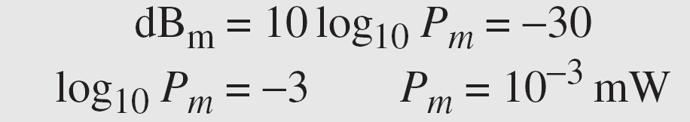
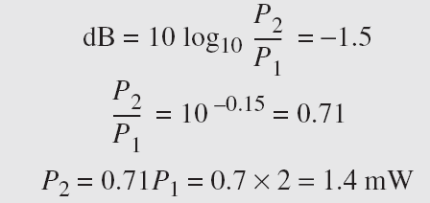
Sometimes the decibel is used to measure signal power in milliwatts. In this case, it is referred to as dB_{m} and is calculated as dB_{m} = 10 log10 P_{m} , where P_{m} is the power in milliwatts. Calculate the power of a signal with dB_{m} = −30.
The loss in a cable is usually defined in decibels per kilometer (dB/km). If the signal at the beginning of a cable with −0.3 dB/km has a power of 2 mW, what is the power of the signal at 5 km?
The loss in the cable in decibels is 5 × (−0.3) = −1.5 dB. We can calculate the power as

Slide 66
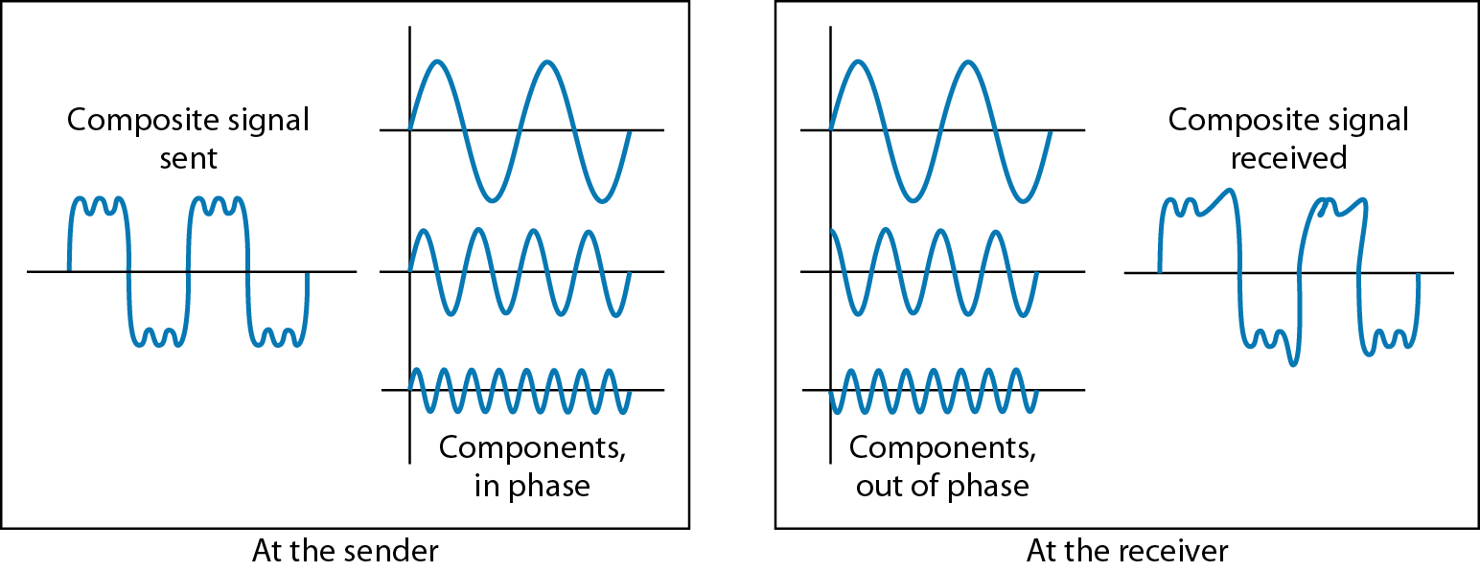
Distortion
Signal changes its form or shape
Distortion can occur in a composite signal made of different frequencies
Each signal component has its own propagation speed through a medium and its own delay in arriving at final destination
Differences in delay may create a difference in phase if the delay is not exactly the same as period duration
Distortion

Slide 67
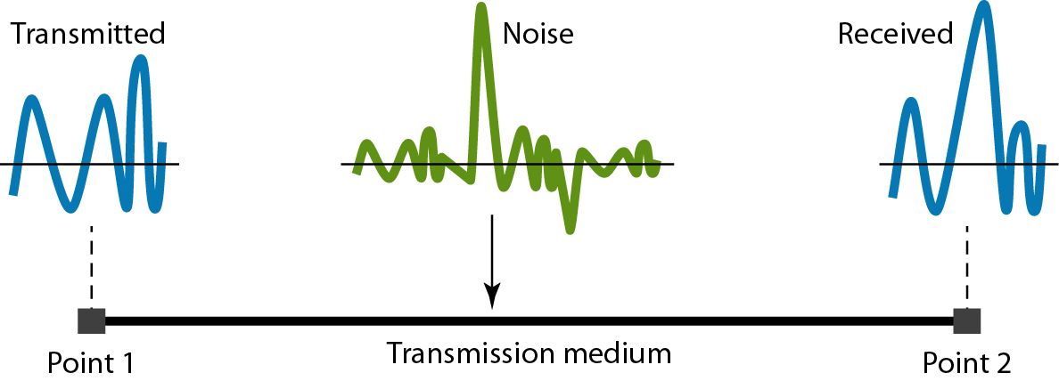
Noise
Thermal Noise - random noise of electrons in the wire creates an extra signal
Induced Noise - from motors and appliances, devices act are transmitter antenna and medium as receiving antenna
Crosstalk Noise - same as above but between two wires
Impulse - Spikes that result from power lines, lightning, etc.
Noise

Slide 68
Noise Measurement
Measured using Signal-to-Noise Ratio (SNR)
SNR is the theoretical bit rate limit
It is usually given in dB and referred to as SNR_{dB.}
SNR = (average signal power)/(average noise power)
SNR is ratio of what is wanted (signal) and what is not wanted (noise)
SNR_{dB} = 10log₁₀SNR

Slide 69
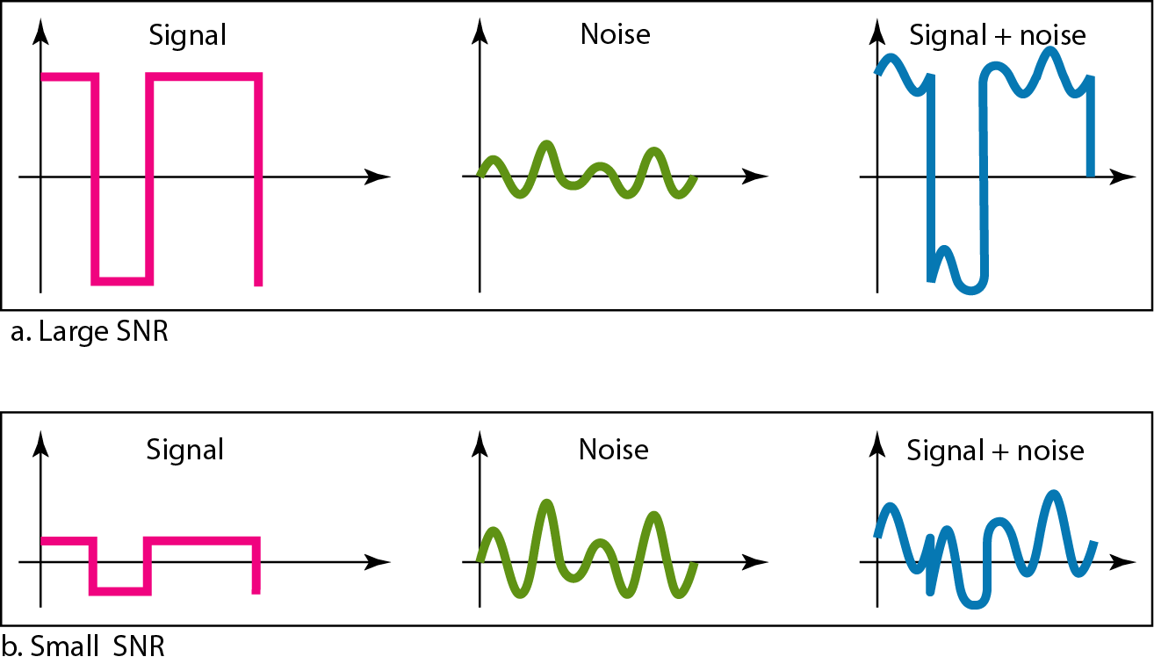
Two cases of SNR: a high SNR and a low SNR

Slide 70
The power of a signal is 10 mW and the power of the noise is 1 μW; what are the values of SNR and SNR_{dB} ?
The values of SNR and SNRdB for a noiseless channel are unachievable as -
We can never achieve this ratio in real life; it is an ideal.

Slide 71
Data rate limits
Noiseless Channel: Nyquist Bit Rate
Noisy Channel: Shannon Capacity
Using Both Limits

Slide 72
Data rate limits
Data rate depends on 3 factors
The bandwidth available
The level of the signals we use
The quality of the channel (the level of noise)
Two theoretical formulas were developed to calculate data rate
By Nyquist for a noiseless channel
By Shannon for a noisy channel

Slide 73
Noiseless channel: nyquist bit rate
Nyquist bit rate defines the theoretical maximum bit rate
BitRate = 2 X bandwidth X log₂L
The bit rate of a system increases with an increase in the number of signal levels we use to denote a symbol.
A symbol can consist of a single bit or “n” bits.
The number of signal levels = 2^{n}.
As the number of levels goes up, the spacing between level decreases, increasing the probability of an error occurring in the presence of transmission impairments
Increasing the signal levels impose burden on receiver to distinguish between different levels
Increasing the levels of a signal increases the probability of an error occurring, in other words it reduces the reliability of the system. Why??

Slide 74
Noiseless channel: nyquist bit rate
Nyquist gives the upper bound for the bit rate of a transmission system by calculating the bit rate directly from the number of bits in a symbol (or signal levels) and the bandwidth of the system (assuming 2 symbols/per cycle and first harmonic)
Nyquist theorem states that for a noiseless channel:
C = 2 B log₂2^{n}
C= capacity in bps
B = bandwidth in Hz

Slide 75
Does the Nyquist theorem bit rate agree with the intuitive bit rate described in baseband transmission?
They match when we have only two levels. In baseband transmission, the bit rate is 2 times the bandwidth if we use only the first harmonic in the worst case. However, the Nyquist formula is more general; it can be applied to baseband transmission and modulation. Also, it can be applied when we have two or more levels of signals.
Consider a noiseless channel with a bandwidth of 3000 Hz transmitting a signal with two signal levels. The maximum bit rate can be calculated as
Consider the same noiseless channel transmitting a signal with four signal levels (for each level, we send 2 bits). The maximum bit rate can be calculated as

Slide 76
We need to send 265 kbps over a noiseless channel with a bandwidth of 20 kHz. How many signal levels do we need?
Since this result is not a power of 2, we need to either increase the number of levels or reduce the bit rate. If we have 128 levels, the bit rate is 280 kbps. If we have 64 levels, the bit rate is 240 kbps

Slide 77
Noisy channel: Shannon capacity
The channel is always noisy
In 1944, Claude Shannon introduced a formula, called the Shannon Capacity, to determine the theoretical highest data rate for a noisy channel:
Capacity = bandwidth X log₂(1+SNR)
There is no indication of the signal level

Slide 78
Consider an extremely noisy channel in which the value of the signal-to-noise ratio is almost zero. In other words, the noise is so strong that the signal is faint. For this channel the capacity C is calculated as
This means that the capacity of this channel is zero regardless of the bandwidth. In other words, we cannot receive any data through this channel.
We can calculate the theoretical highest bit rate of a regular telephone line. A telephone line normally has a bandwidth of 3000. The signal-to-noise ratio is usually 3162. For this channel the capacity is calculated as
This implies that the highest bit rate for a telephone line is 34.860 kbps. If we want to send data faster than this, we can either increase the bandwidth of the line or improve the signal-to-noise ratio

Slide 79


The signal-to-noise ratio is often given in decibels. Assume that SNR_{dB} = 36 and the channel bandwidth is 2 MHz. The theoretical channel capacity can be calculated as
For practical purposes, when the SNR is very high, we can assume that SNR + 1 is almost the same as SNR. In these cases, the theoretical channel capacity can be simplified to
We can calculate the theoretical capacity of the previous example as

Slide 80
Using both limits
We have a channel with a 1-MHz bandwidth. The SNR for this channel is 63. What are the appropriate bit rate and signal level?
We use the Shannon formula to find the upper limit
For better performance we choose something lower, 4 Mbps, for example. Then we use the Nyquist formula to find the number of signal levels

Slide 81
We have a channel with a 1-MHz bandwidth. The SNR for this channel is 63. What are the appropriate bit rate and signal level?
we use the Shannon formula to find the upper limit
For better performance we choose something lower, 4 Mbps, for example. Then we use the Nyquist formula to find the number of signal levels
The Shannon capacity gives us the upper limit; the Nyquist formula tells us how many signal levels we need

Slide 82
performance
Bandwidth
Throughput
Latency
Bandwidth Delay Product
Jitter

Slide 83
bandwidth
Bandwidth is used in two contexts
Bandwidth in Hertz
refers to the range of frequencies in a composite signal or the range of frequencies that a channel can pass
Bandwidth in Bits per Second
refers to the speed of bit transmission in a channel or link;
often referred to as Capacity

Slide 84
The bandwidth of a subscriber line is 4 kHz for voice or data. The bandwidth of this line for data transmission can be up to 56,000 bps using a sophisticated modem to change the digital signal to analog.
If the telephone company improves the quality of the line and increases the bandwidth to 8 kHz, we can send 112,000 bps by using the same technology as mentioned in Example 3.42.

Slide 85
throughput
Measure of how fast we can actually send data through a network
Bandwidth Vs Throughput
Bandwidth is a potential measurement of a link
Throughput is an actual measurement of how fast we can send data
Link with a bandwidth of 1Mbps, but devices connected may handle only 200 kbps
Hence, we can’t send more than 200 kbps through this link

Slide 86

A network with bandwidth of 10 Mbps can pass only an average of 12,000 frames per minute with each frame carrying an average of 10,000 bits. What is the throughput of this network?
The throughput is almost one-fifth of the bandwidth in this case.

Slide 87
Latency (delay)
Defines how long it takes for an entire message to completely arrive at the destination from the time the first bit is sent out from the source
Made of four components
Propagation time
Transmission time
Queuing time
Processing delay
Latency = propagation time + transmission time + queuing time + processing delay

Slide 88
Propagation Time
Measures the time required for a bit to travel from the source to the destination
Calculated by dividing the distance by propagation speed
Propagation Delay = Distance/Propagation speed
What is the propagation time if the distance between the two points is 12,000 km? Assume the propagation speed to be 2.4 × 108 m/s in cable.
The example shows that a bit can go over the Atlantic Ocean in only 50 ms if there is a direct cable between the source and the destination

Slide 89
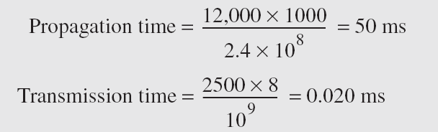
Transmission Time
There is a time between the first bit leaving the sender and the last bit arriving at the receiver
Transmission time depends on size of the message and the bandwidth of the channel
Transmission time = (Message Size) / Bandwidth
What are the propagation time and the transmission time for a 2.5-kbyte message (an e-mail) if the bandwidth of the network is 1 Gbps? Assume that the distance between the sender and the receiver is 12,000 km and that light travels at 2.4 × 108 m/s.
Note that in this case, because the message is short and the bandwidth is high, the dominant factor is the propagation time, not the transmission time. The transmission time can be ignored.

Slide 90
What are the propagation time and the transmission time for a 5-Mbyte message (an image) if the bandwidth of the network is 1 Mbps? Assume that the distance between the sender and the receiver is 12,000 km and that light travels at 2.4 × 10⁸ m/s.
Note that in this case, because the message is very long and the bandwidth is not very high, the dominant factor is the transmission time, not the propagation time. The propagation time can be ignored.

Slide 91
Queuing Time
Time needed for each intermediate or end device to hold the message before it can be processed
Not a fixed factor; it changes with the load imposed on the network
When there is heavy traffic on the network, queuing time increases
Routers queue the packets

Slide 92
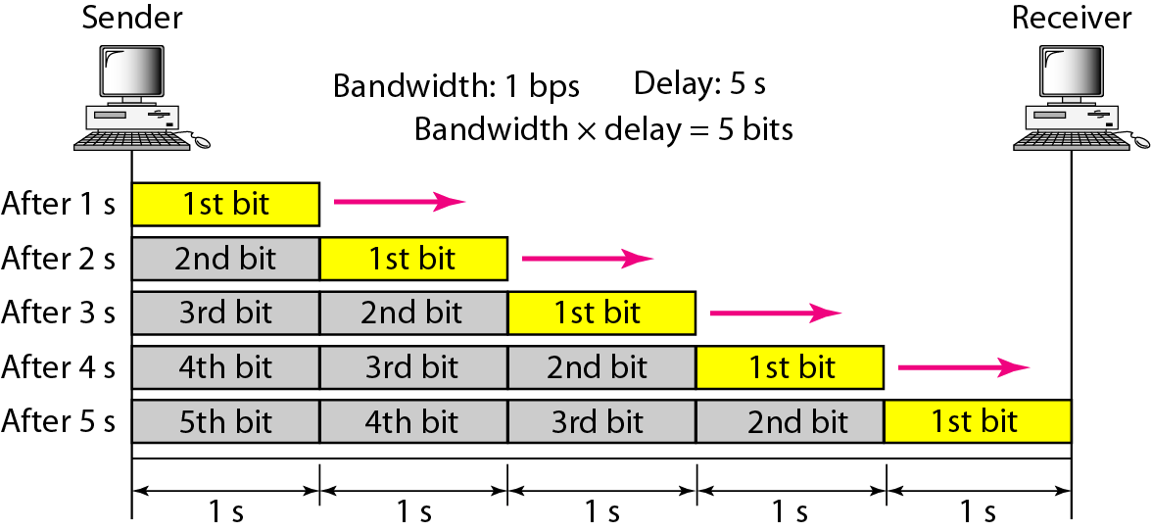
Bandwidth delay product
Bandwidth and delay are two performance metrics of a link
Filling the link with bits for Case 1

Slide 93
We can think about the link between two points as a pipe. The cross section of the pipe represents the bandwidth, and the length of the pipe represents the delay. We can say the volume of the pipe defines the bandwidth-delay product
Filling the link with bits for Case 2

Slide 94

Concept of Bandwidth Delay Product
The bandwidth-delay product defines the number of bits that can fill the link

Slide 95
Jitter
Jitter is a problem if different packets of data encounter different delays and the application using the data at the receiver site is time-sensitive

Slide 96
Thank you!!!
Any Questions!!!

